Slide 1
Client and Server Sockets in Java
CIT 360
Dan Hively

Slide 2


Client and Server Sockets?
Not this

Slide 3
What is a Socket?
A natural or artificial hollow into which something fits or in which something revolves.
A socket is one endpoint of a two-way communication link between two programs running on the network.
bound to a port number
the TCP layer can identify the application to which data is destined to be sent

Slide 4
Server Side
It runs on a specific computer or process
Has a socket that is bound to a specific port number.
The server just waits, listening to the socket for a client to make a connection request.

Slide 5
Client Side
Knows the
hostname on which the server is running
port number on which the server is listening
To make a connection request, the client tries to rendezvous with the server on the server's machine and port.
The client also needs to identify itself to the server so it binds to a local port number that it will use during this connection.

Slide 6

How does it work?
Server listens
Client makes a request

Slide 7

How does it work?
Server accepts the connection
Server gets a new socket bound to the same local port and also has its remote endpoint set to the address and port of the client.
It needs a new socket so that it can continue to listen to the original socket for connection requests while tending to the needs of the connected client.

Slide 8
How does it work?
On the client side, if the connection is accepted, a socket is successfully created and the client can use the socket to communicate with the server.
The client and server can now communicate by writing to or reading from their sockets.

Slide 9
Example 1
To send "Hello, world!" via TCP to port 80 of the host with address 1.2.3.4
get a socket
connect it to the remote host
send the string
close the socket

Slide 10
Example 1
Socket socket = getSocket(type = "TCP")
connect(socket, address = "1.2.3.4", port = "80")
send(socket, "Hello, world!")
close(socket)

Slide 11
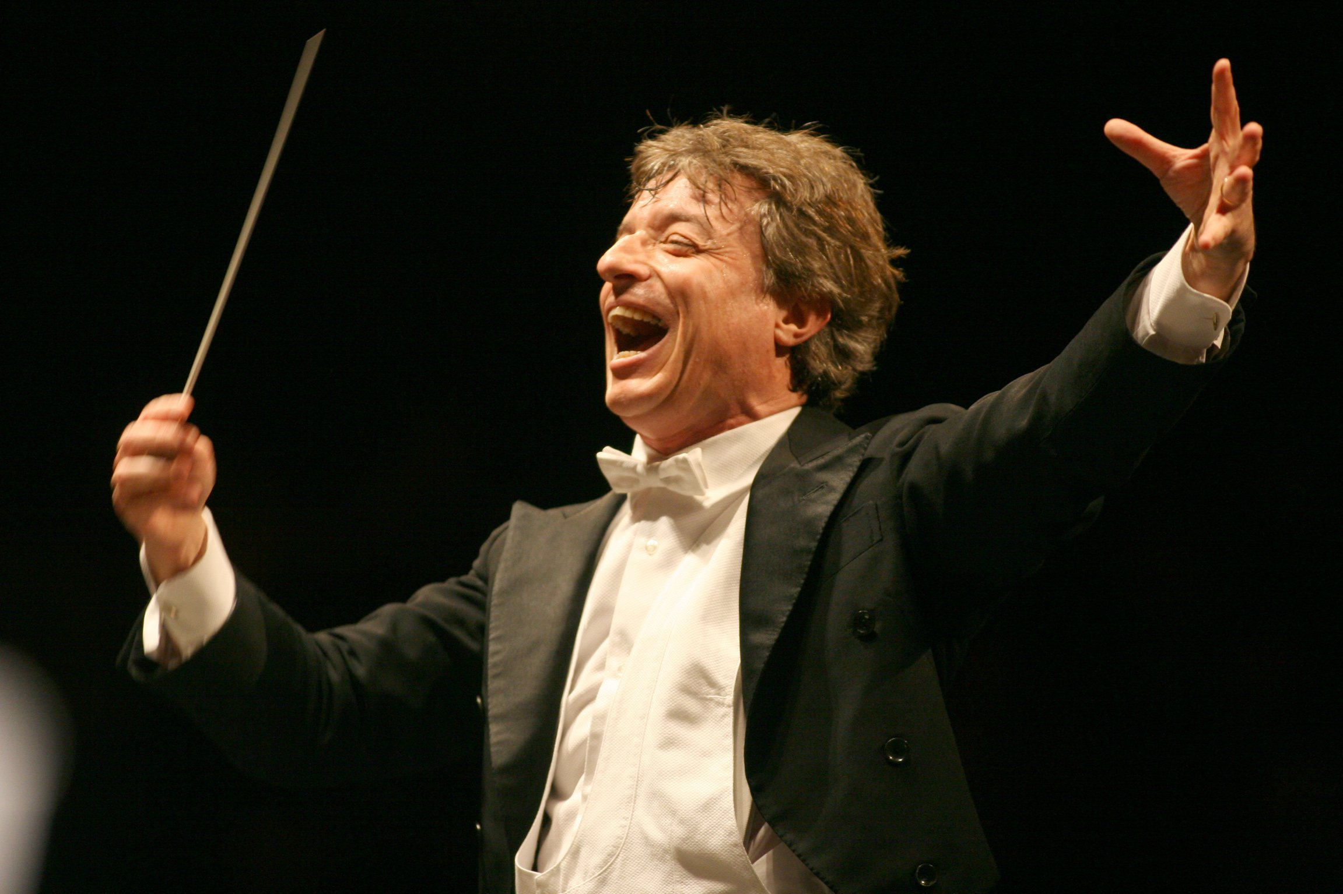
Demo Time!

Slide 12

Client and Server Sockets

